Slide 1
Digital Portfolio
STUDENT NAME: P.Gowtham anandh
REGISTER NO AND NMID: 222404558/asunm130124j009
DEPARTMENT: bsc.software application
COLLEGE: COLLEGE/ UNIVERSITY:A.m jain college

Slide 2
PROJECT TITLE DIGITAL PORTFOLIO

Slide 3


AGENDA
Problem Statement
Project Overview
End Users
Tools and Technologies
Portfolio design and Layout
Features and Functionality
Results and Screenshots
Conclusion
Github Link
3/21/2024 Annual Review

Slide 4

PROBLEM STATEMENT 1)Building the structure 2)Giving perfect colors 3)Inserting pictures 4)Making scrolling smooth 5)Makling it responsive

Slide 5
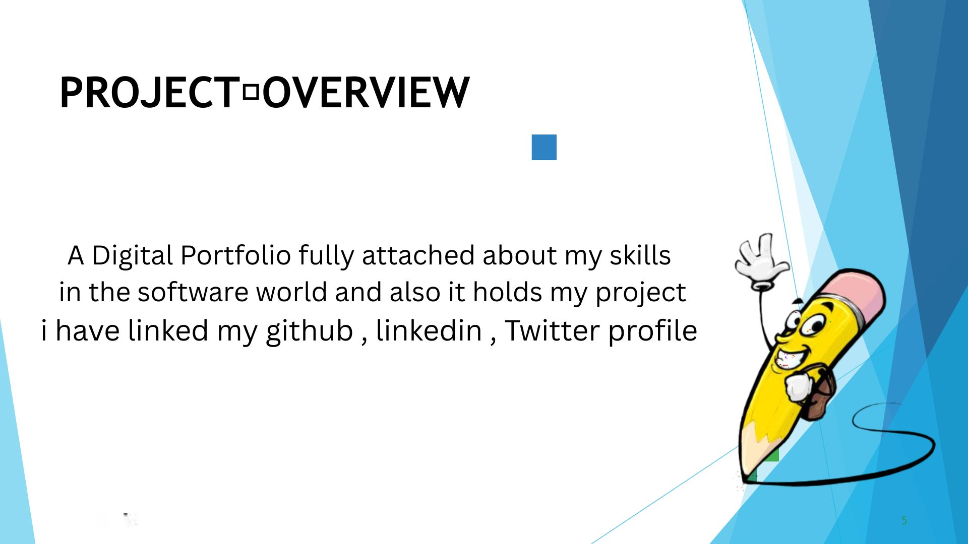

PROJECT OVERVIEW

Slide 6
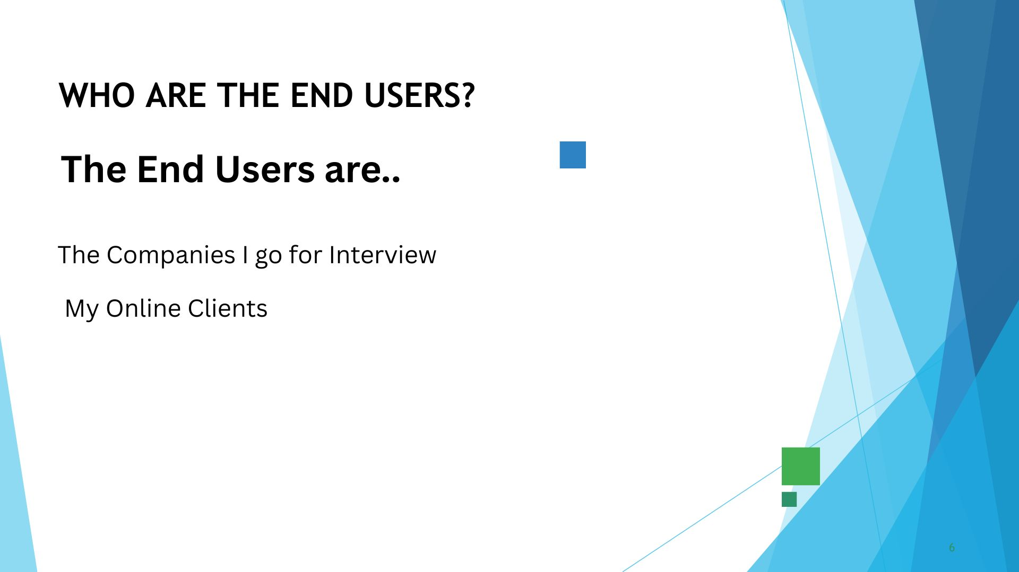

WHO ARE THE END USERS?

Slide 7

TOOLS AND TECHNIQUES HTML CSS JAVA SCRIPT

Slide 8
POTFOLIO DESIGN AND LAYOUT
8

Slide 9
FEATURES AND FUNCTIONALITY

Slide 10

RESULTS AND SCREENSHOTS
3/21/2024 Annual Review
10

Slide 11
CONCLUSION
11

